Slide 1
Transformers - II
Lecture 8
Part 4
Generative AI for Computer Vision

Slide 2
Content
How Attention is computed?
Self attention
Masked Self Attention
Multi-head Self-attention

Slide 3

How attention is computed in Image Captioning?
Inputs :
Features : z (Dimension : H x W x D)
Query : h (Dimension :D)
Features
In transformer, separate fully connected (FC) linear transformations are applied to the input to generate three distinct representations:
Query (Q), Key (K), and Value (V).
The Query and Key vectors are used to compute alignment scores in the self-attention mechanism, while the Value vectors are used to construct the final weighted output.
Z_{0,0}
Z_{0,1}
Z_{0,2}
CNN
Z_{1,0}
Z_{1,1}
Z_{1,2}
Z_{2,0}
Z_{2,1}
Z_{2,2}
Extract spatial features from a pretrained CNN
h

Slide 4
How attention is computed in Image Captioning?
Features
Inputs :
  Features : z (Dimension : H x W x D)
  Query : h (Dimension :D)
Z_{0,0}
Z_{0,1}
Z_{0,2}
Z_{1,0}
Z_{1,1}
Z_{1,2}
Z_{2,0}
Z_{2,1}
Z_{2,2}
In an attention mechanism, the alignment score measures how well a query matches a key.
It indicates the importance or relevance of each key to the given query.
e_{0,0}
e_{0,1}
e_{0,2}
h
e_{1,0}
e_{1,1}
e_{1,2}
e_{2,0}
e_{2,1}
e_{2,2}
Alignment
Operations :
Alignment : e_{i,j} = f_{all}(h, z_{i,j})

Slide 5
How attention is computed in Image Captioning?
Features
Inputs :
  Features : z (Dimension : H x W x D)
  Query : h (Dimension :D)
Z_{0,0}
Z_{0,1}
Z_{0,2}
Z_{1,0}
Z_{1,1}
Z_{1,2}
Z_{2,0}
Z_{2,1}
Z_{2,2}
Once the alignment scores are calculated between a query and all the keys, they are passed through a softmax function to convert them into attention weights.
e_{0,0}
e_{0,1}
e_{0,2}
a_{0,0}
a_{0,1}
a_{0,2}
h
e_{1,0}
e_{1,1}
e_{1,2}
Softmax
a_{1,0}
a_{1,1}
a_{1,2}
e_{2,0}
e_{2,1}
e_{2,2}
a_{2,0}
a_{2,1}
a_{2,2}
Alignment
Attention
Operations :
Alignment : e_{i,j} = f_{all}(h, z_{i,j})
Attention : a = Softmax(e)

Slide 6
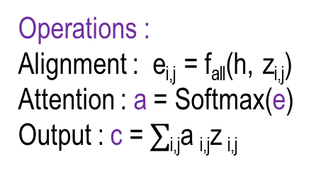
How attention is computed in Image Captioning?
The context vector is obtained by taking the weighted sum of the value vectors using the attention weights.
Each value vector (here Features) is then multiplied by its corresponding attention weight, and all the weighted values are added together.
The resulting vector is the context vector, which contains the most relevant information from the input sequence for the current query.
Features
Z_{0,0}
Z_{0,1}
Z_{0,2}
Z_{1,0}
Z_{1,1}
Z_{1,2}
Z_{2,0}
Z_{2,1}
Z_{2,2}
e_{0,0}
e_{0,1}
e_{0,2}
a_{0,0}
a_{0,1}
a_{0,2}
h
e_{1,0}
e_{1,1}
e_{1,2}
Softmax
a_{1,0}
a_{1,1}
a_{1,2}
mul + add
c
e_{2,0}
e_{2,1}
e_{2,2}
a_{2,0}
a_{2,1}
a_{2,2}
Alignment
Attention
Inputs :
  Features : z (Dimension : H x W x D)
  Query : h (Dimension :D)
Operations :
Alignment : e_{i,j} = f_{all}(h, z_{i,j})
Attention : a = Softmax(e)
Output : c = $∑$_{i,j}a _{i,j}z _{i,j}
Outputs :
  Context vector : c Dimension : D)

Slide 7

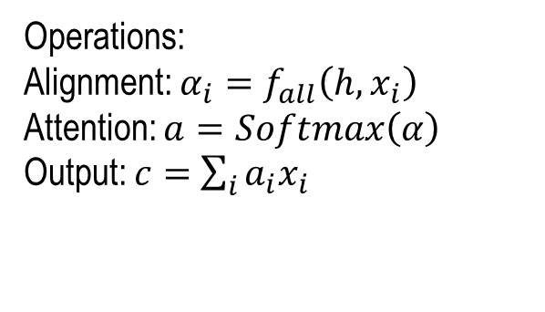










Attention Layer
Operations:
Alignment: $α_{i}=f_{all}\left(h,x_{i}\right)$
Attention: $a=Softmax\left(α\right)$
Output: $c=$ $\sum_{i}{a_{i}x_{i}}$
Inputs:
Input Vector X (Dimension : NxD)
Query Vector h (Dimension : D)
Alignment
Attention
$$h$$
$$α_{3}$$
$$α_{2}$$
$$α_{1}$$
softmax
$$a_{3}$$
$$a_{2}$$
$$a_{1}$$
mul + add
$$c$$
$$x_{3}$$
$$x_{2}$$
$$x_{1}$$
Output:
Context Vector C (Dimension : D)
Input Vectors
Concept: Fei-Fei Li Attention and Transformers CS231n Stanford Lecture

Slide 8

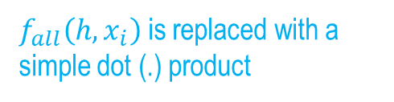










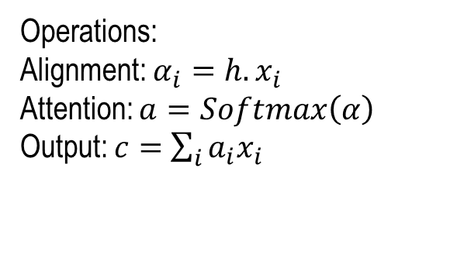
Attention Layer
Operations:
Alignment: $α_{i}=h.x_{i}$
Attention: $a=Softmax\left(α\right)$
Output: $c=$ $\sum_{i}{a_{i}x_{i}}$
$f_{all}\left(h,x_{i}\right)$ is replaced with a simple dot (.) product
Inputs:
Input Vector X (Dimension : NxD)
Query Vector h (Dimension : D)
Alignment
Attention
$$h$$
$$α_{3}$$
$$α_{2}$$
$$α_{1}$$
softmax
$$a_{3}$$
$$a_{2}$$
$$a_{1}$$
mul + add
$$c$$
$$x_{3}$$
$$x_{2}$$
$$x_{1}$$
Output:
Context Vector C (Dimension : D)
Input Vectors
Concept: Fei-Fei Li Attention and Transformers CS231n Stanford Lecture

Slide 9


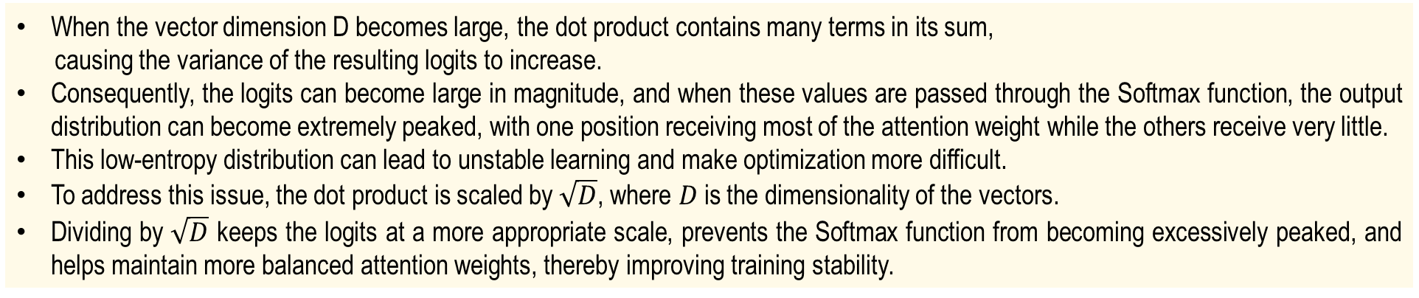


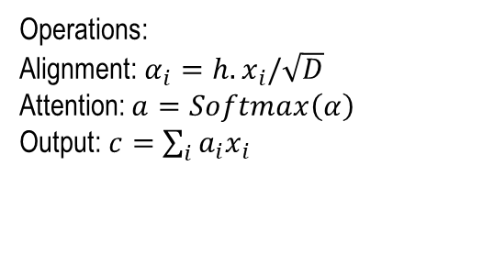







Attention Layer
When the vector dimension D becomes large, the dot product contains many terms in its sum,
causing the variance of the resulting logits to increase.
Consequently, the logits can become large in magnitude, and when these values are passed through the Softmax function, the output distribution can become extremely peaked, with one position receiving most of the attention weight while the others receive very little.
This low-entropy distribution can lead to unstable learning and make optimization more difficult.
To address this issue, the dot product is scaled by $\sqrt{D}$, where $D$is the dimensionality of the vectors.
Dividing by $\sqrt{D}$ keeps the logits at a more appropriate scale, prevents the Softmax function from becoming excessively peaked, and helps maintain more balanced attention weights, thereby improving training stability.
Operations:
Alignment: $α_{i}=h.x_{i}/\sqrt{D}$
Attention: $a=Softmax\left(α\right)$
Output: $c=$ $\sum_{i}{a_{i}x_{i}}$
Inputs:
Input Vector X (Dimension : NxD)
Query Vector h (Dimension : D)
Alignment
Attention
$$h$$
$$α_{3}$$
$$α_{2}$$
$$α_{1}$$
softmax
$$a_{3}$$
$$a_{2}$$
$$a_{1}$$
mul + add
$$c$$
Output:
Context Vector C (Dimension : D)
$$x_{3}$$
$$x_{2}$$
$$x_{1}$$
Input Vectors
Concept: Fei-Fei Li Attention and Transformers CS231n Stanford Lecture

Slide 10










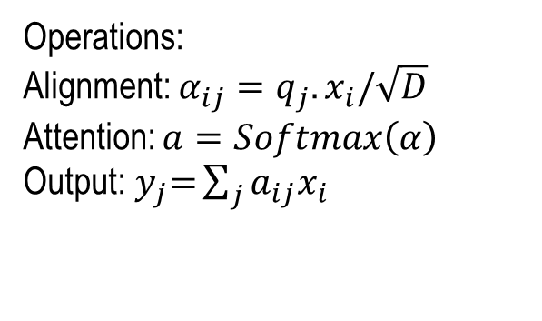

















Attention Layer
As each query vector may obtain a different context, so there are multiple context vectors because of multiple query vectors.
Operations:
Alignment: $α_{ij}=q_{j}.x_{i}/\sqrt{D}$
Attention: $a=Softmax\left(α\right)$
Output:${ y}_{j}=$ $\sum_{j}{a_{ij}x_{i}}$
Inputs:
Input Vector X (Dimension : NxD)
Query Vector q (Dimension : MxD)
Alignment
Attention
$$q_{3}$$
$$α_{33}$$
$$α_{2,3}$$
$$α_{1,3}$$
$$a_{3,3}$$
$$a_{2,3}$$
$$a_{1,3}$$
$$y_{3}$$
Softmax()
(→)
Mul
+
Add
(→)
$$q_{2}$$
(↑)
$$y_{2}$$
$$α_{32}$$
$$α_{2,2}$$
$$α_{1,2}$$
$$a_{3,2}$$
$$a_{2,2}$$
$$a_{1,2}$$
$$q_{1}$$
$$α_{31}$$
$$α_{2,1}$$
$$α_{1,1}$$
$$a_{3,1}$$
$$a_{2,1}$$
$$a_{1,1}$$
$$y_{1}$$
$$x_{3}$$
$$x_{2}$$
$$x_{1}$$
Output:
Context Vector y (Dimension : D)
Input Vectors
Concept: Fei-Fei Li Attention and Transformers CS231n Stanford Lecture

Slide 11
Attention Layer
In the attention mechanism of a Transformer, the same input representations may initially be used both to determine the alignment between tokens by computing attention scores and to generate the final attention output.
However, using a single representation for both purposes can limit the model’s flexibility and expressive capacity.
To overcome this limitation, separate fully connected (FC) linear transformations are applied to the input representations to produce distinct representations for different roles within the attention mechanism.
This allows the model to learn specialized projections for computing attention scores and generating the final output, thereby increasing the expressive power and flexibility of the layer.
Concept: Fei-Fei Li Attention and Transformers CS231n Stanford Lecture

Slide 12










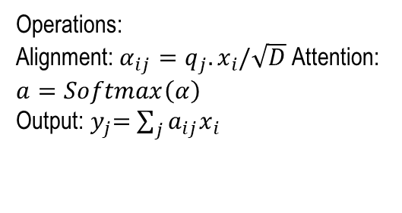

















Attention Layer
Inputs:
Input Vector X (Dimension : NxD)
Query Vector q (Dimension : MxD)
Operations:
Alignment: $α_{ij}=q_{j}.x_{i}/\sqrt{D}$ Attention: $a=Softmax\left(α\right)$
Output:${ y}_{j}=$ $\sum_{j}{a_{ij}x_{i}}$
Alignment
Attention
$$q_{3}$$
$$α_{33}$$
$$α_{2,3}$$
$$α_{1,3}$$
$$a_{3,3}$$
$$a_{2,3}$$
$$a_{1,3}$$
$$y_{3}$$
Softmax()
(→)
Mul
+
Add
(→)
$$q_{2}$$
(↑)
$$y_{2}$$
$$α_{32}$$
$$α_{2,2}$$
$$α_{1,2}$$
$$a_{3,2}$$
$$a_{2,2}$$
$$a_{1,2}$$
$$q_{1}$$
$$α_{31}$$
$$α_{2,1}$$
$$α_{1,1}$$
$$a_{3,1}$$
$$a_{2,1}$$
$$a_{1,1}$$
$$y_{1}$$
$$x_{3}$$
$$x_{2}$$
$$x_{1}$$
Output:
Context Vector y
(Dimension : D)
Input Vectors
Concept: Fei-Fei Li Attention and Transformers CS231n Stanford Lecture

Slide 13












Attention Layer
These transformations generate three distinct vector representations: Query (Q), Key (K), and Value (V).
The Query and Key vectors are used to compute alignment scores through the self-attention mechanism, determining how strongly each token should attend to the others, while the Value vectors are used to construct the final weighted representation.
By applying separate linear transformations to generate Q, K, and V, the model can learn specialized feature representations for measuring token relationships and producing the output.
This separation increases the flexibility and expressive power of the attention mechanism, enabling the model to capture more complex relationships and dependencies within the input data.
$$q_{3}$$
Inputs:
Input Vector X
(Dimension : NxD)
Query Vector q
(Dimension : MxD_{k})
$$q_{2}$$
Operations:
Key Vectors: k=xW_{k}
Value Vectors: v=xW_{v}
$$q_{1}$$
$$k_{3}$$
$$k_{2}$$
$$k_{1}$$
$$v_{3}$$
$$v_{2}$$
$$v_{1}$$
$$x_{3}$$
$$x_{2}$$
$$x_{1}$$
Input Vectors
Concept: Fei-Fei Li Attention and Transformers CS231n Stanford Lecture

Slide 14











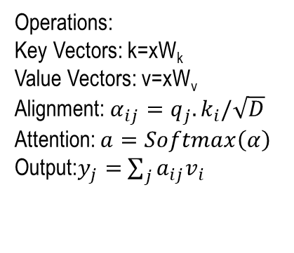






















Attention Layer
In this setup, the input vectors are used both for computing the alignment scores and for performing the attention calculations.
Since the fully connected (FC) layers used to generate the Query, Key, and Value representations can have different dimensions, the attention mechanism is not restricted to a fixed input or output dimensionality.
In particular, the dimensions of the Key and Value projections can determine the dimensionality of the attention computations and the resulting representation.
This flexibility allows the model to learn more specialized feature representations and capture complex relationships within the input data.
Operations:
Key Vectors: k=xW_{k}
Value Vectors: v=xW_{v}
Alignment: $α_{ij}=q_{j}.k_{i}/\sqrt{D}$
Attention: $a=Softmax\left(α\right)$
Output:$y_{j}=$ $\sum_{j}{a_{ij}v_{i}}$
Alignment
Attention
$$q_{3}$$
$$α_{33}$$
$$α_{2,3}$$
$$α_{1,3}$$
$$a_{3,3}$$
$$a_{2,3}$$
$$a_{1,3}$$
$$y_{3}$$
softmax
(→)
Mul
+
Add
(→)
$$q_{2}$$
$$α_{32}$$
$$α_{2,2}$$
$$α_{1,2}$$
$$a_{3,2}$$
$$a_{2,2}$$
$$a_{1,2}$$
(↑)
$$y_{2}$$
$$q_{1}$$
$$α_{31}$$
$$α_{2,1}$$
$$α_{1,1}$$
$$a_{3,1}$$
$$a_{2,1}$$
$$a_{1,1}$$
$$y_{1}$$
Inputs:
Input Vector X (Dimension : NxD)
Query Vector q (Dimension : MxD_{k})
$$k_{3}$$
$$k_{2}$$
$$k_{1}$$
$$v_{3}$$
$$v_{2}$$
$$v_{1}$$
Output:
Context Vector y (Dimension : D_{v})
$$x_{3}$$
$$x_{2}$$
$$x_{1}$$
Input Vectors
Concept: Fei-Fei Li Attention and Transformers CS231n Stanford Lecture

Slide 15
Query, Key, and Value Projections in Attention
In the attention mechanism of a Transformer, the input vectors are initially used for both computing alignment scores and generating the attention output.
The alignment step determines how strongly different tokens relate to one another, while the attention calculation uses these relationships to produce a weighted representation.
However, using the same representations for both purposes can limit the model’s flexibility and expressive power.
To address this limitation, separate fully connected (FC) linear transformations are applied to the input to generate three distinct representations: Query (Q), Key (K), and Value (V).

Slide 16
Query, Key, and Value Projections in Attention
The Query and Key vectors are used to compute alignment scores in the self-attention mechanism, while the Value vectors are used to construct the final weighted output.
Since these FC transformations can have different dimensions, the attention mechanism can operate with different key and value representations and can map the input to an output space of a different dimensionality.
This added flexibility enables the model to learn more specialized representations and capture complex relationships and dependencies within the data.

Slide 17



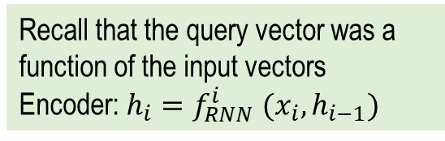







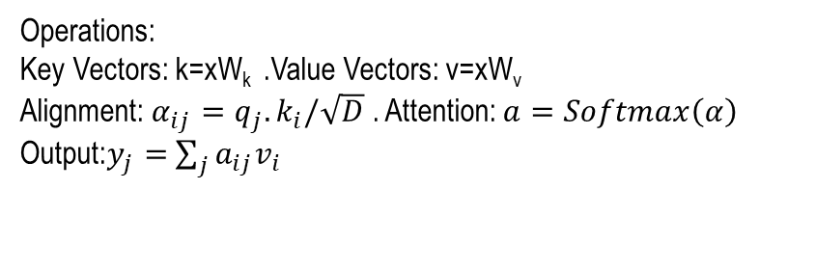























Attention Layer
Recall that the query vector was a
function of the input vectors
Encoder: $h_{i}=f_{RNN}^{i} (x_{i},h_{i−1})$
Inputs:
Input Vector X (dimension : NxD)
Query Vector q (dimension : MxD_{k})
Operations:
Key Vectors: k=xW_{k} .Value Vectors: v=xW_{v}
Alignment: $α_{ij}=q_{j}.k_{i}/\sqrt{D}$ . Attention: $a=Softmax\left(α\right)$
Output:$y_{j}=$ $\sum_{j}{a_{ij}v_{i}}$
Alignment
Attention
$$q_{3}$$
$$α_{33}$$
$$α_{2,3}$$
$$α_{1,3}$$
$$a_{3,3}$$
$$a_{2,3}$$
$$a_{1,3}$$
$$y_{3}$$
softmax
(→)
Mul
+
Add
(→)
$$q_{2}$$
$$α_{32}$$
$$α_{2,2}$$
$$α_{1,2}$$
$$a_{3,2}$$
$$a_{2,2}$$
$$a_{1,2}$$
(↑)
$$y_{2}$$
$$q_{1}$$
$$α_{31}$$
$$α_{2,1}$$
$$α_{1,1}$$
$$a_{3,1}$$
$$a_{2,1}$$
$$a_{1,1}$$
$$y_{1}$$
$$k_{3}$$
$$k_{2}$$
$$k_{1}$$
$$v_{3}$$
$$v_{2}$$
$$v_{1}$$
Output:
Context Vector y (Shape: D_{v})
$$x_{3}$$
$$x_{2}$$
$$x_{1}$$
Input Vectors
Concept: Fei-Fei Li Attention and Transformers CS231n Stanford Lecture

Slide 18
Self-attention
Self-attention is a fundamental mechanism in the Transformer architecture that enables each element in a sequence to consider and weigh the importance of all other elements when generating its representation.
The main difference between attention and self-attention lies in where the Query, Key, and Value vectors come from.
In general attention, the Query may come from one sequence while the Key and Value vectors come from another sequence, allowing the model to focus on relevant information from a different source.
In contrast, self-attention generates the Query, Key, and Value vectors from the same input sequence, allowing each token to attend to other tokens within that sequence.
Thus, self-attention is a specific form of attention that enables the model to capture relationships and dependencies among elements of the same sequence.

Slide 19
Self-attention
In self-attention, the input vectors are passed through fully connected (FC) linear layers to produce three different representations: Query (Q), Key (K), and Value (V).
The Query of a token is compared with the Keys of all tokens to compute attention scores, which indicate the relevance of each token to the current token.
These scores are normalized using the Softmax function and then used to compute a weighted sum of the Value vectors, producing a context-aware representation.
This mechanism allows the model to capture relationships and dependencies between tokens regardless of their distance in the image.
As a result, self-attention has become a core component of modern Transformer-based language models, including BERT and GPT (Generative Pre-trained Transformer).

Slide 20



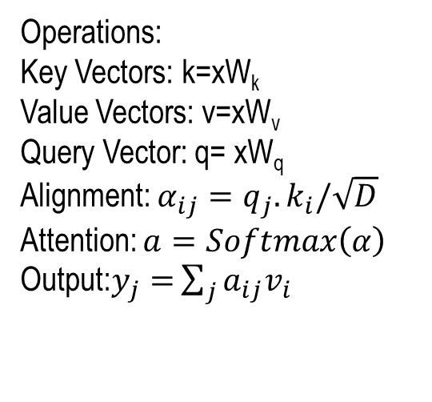



Self Attention Layer
Inputs:
Input Vector X
(Dimension : NxD)
Query Vector q (shape : MxD_{k})
$$q_{3}$$
$$q_{2}$$
Operations:
Key Vectors: k=xW_{k}
Value Vectors: v=xW_{v}
Query Vector: q= xW_{q}
Alignment: $α_{ij}=q_{j}.k_{i}/\sqrt{D}$
Attention: $a=Softmax\left(α\right)$
Output:$y_{j}=$ $\sum_{j}{a_{ij}v_{i}}$
$$q_{1}$$
$$x_{3}$$
$$x_{2}$$
$$x_{1}$$
Input Vectors
Concept: Fei-Fei Li Attention and Transformers CS231n Stanford Lecture

Slide 21
Self Attention Layer
In this setup, the Query vectors are generated through a learned fully connected (FC) linear transformation of the input, eliminating the need for separate or external query inputs.
The resulting Queries are compared with the Key vectors to compute attention scores, which determine the relevance of each element in the sequence to the others.
These attention scores are then applied to the Value vectors to produce the final context-aware representation.
This design enables the model to learn relationships and dependencies among elements within the same sequence efficiently and allows each element to dynamically incorporate relevant information from the entire sequence.

Slide 22







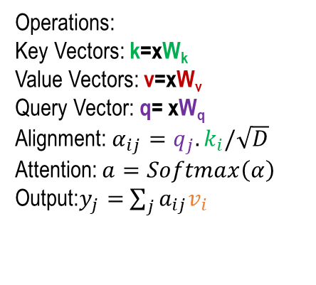
































Self Attention Layer
$$y_{1}$$
$$y_{2}$$
$$y_{3}$$
Operations:
Key Vectors: k=xW_{k}
Value Vectors: v=xW_{v}
Query Vector: q= xW_{q}
Alignment: $α_{ij}=q_{j}.k_{i}/\sqrt{D}$
Attention: $a=Softmax\left(α\right)$
Output:$y_{j}=$ $\sum_{j}{a_{ij}v_{i}}$
Self Attention
$$x_{1}$$
$$x_{2}$$
$$x_{3}$$
Alignment
Attention
$$q_{3}$$
$$α_{33}$$
$$α_{2,3}$$
$$α_{1,3}$$
$$a_{3,3}$$
$$a_{2,3}$$
$$a_{1,3}$$
$$y_{3}$$
softmax
(→)
Mul
+
Add
(→)
$$q_{2}$$
$$α_{32}$$
$$α_{2,2}$$
$$α_{1,2}$$
$$a_{3,2}$$
$$a_{2,2}$$
$$a_{1,2}$$
(↑)
$$y_{2}$$
$$q_{1}$$
$$α_{31}$$
$$α_{2,1}$$
$$α_{1,1}$$
$$a_{3,1}$$
$$a_{2,1}$$
$$a_{1,1}$$
$$y_{1}$$
$$k_{3}$$
$$k_{2}$$
$$k_{1}$$
$$v_{3}$$
$$v_{2}$$
$$v_{1}$$
Inputs:
Input Vector X
(Dimension : NxD)
$$x_{3}$$
$$x_{2}$$
$$x_{1}$$
Output:
Context Vector y (Dimension : D_{v})
Input Vectors
Concept: Fei-Fei Li Attention and Transformers CS231n Stanford Lecture

Slide 23
Masked Self-Attention Layer
A masked self-attention layer is a variant of self-attention commonly used in autoregressive Transformer models to ensure that each token can attend only to itself and the tokens that appear before it in the sequence.
A mask is applied to the attention scores to prevent a token from accessing future tokens during training.
Typically, the scores corresponding to future positions are set to a very large negative value before applying the Softmax function, causing their attention weights to become effectively zero.
This prevents information from future tokens from leaking into the current prediction and ensures that the model learns to generate or predict tokens sequentially.
Masked self-attention is therefore essential in decoder-based architectures such as GPT, where predictions must depend only on previously available information.

Slide 24











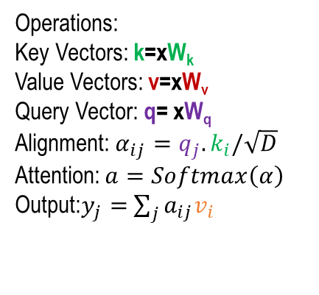






















Masked self-attention layer
Operations:
Key Vectors: k=xW_{k}
Value Vectors: v=xW_{v}
Query Vector: q= xW_{q}
Alignment: $α_{ij}=q_{j}.k_{i}/\sqrt{D}$
Attention: $a=Softmax\left(α\right)$
Output:$y_{j}=$ $\sum_{j}{a_{ij}v_{i}}$
This layer prevents vectors from looking at future vectors.
  Alignment scores is set to minus infinity
Inputs:
Input Vector X (Dimension : NxD)
Alignment
Attention
$$q_{3}$$
$$α_{33}$$
$$α_{2,3}$$
$$α_{1,3}$$
$$a_{3,3}$$
$$a_{2,3}$$
$$a_{1,3}$$
$$y_{3}$$
softmax
(→)
Mul
+
Add
(→)
$$q_{2}$$
$$−∞$$
$$α_{2,2}$$
$$α_{1,2}$$
$$0$$
$$a_{2,2}$$
$$a_{1,2}$$
(↑)
$$y_{2}$$
$$q_{1}$$
$$−∞$$
$$−∞$$
$$α_{1,1}$$
$$0$$
$$0$$
$$a_{1,1}$$
$$y_{1}$$
$$k_{3}$$
$$k_{2}$$
$$k_{1}$$
$$v_{3}$$
$$v_{2}$$
$$v_{1}$$
Output:
Context Vector y (Dimension: D_{v})
$$x_{3}$$
$$x_{2}$$
$$x_{1}$$
Input Vectors
Concept: Fei-Fei Li Attention and Transformers CS231n Stanford Lecture

Slide 25
Multi-head Self-attention Layer
The Multi-Head Self-Attention layer is a key component of the Transformer architecture that allows the model to focus on different parts of an input sequence simultaneously.
It works by transforming the input into three representations called Query (Q), Key (K), and Value (V) and calculating attention scores to determine how strongly each word should attend to other words in the sequence.
In multi-head attention, this process is performed across multiple attention heads, allowing the model to capture different types of relationships and contextual information at the same time. The outputs from all the attention heads are then combined and passed through a linear transformation.
This mechanism enables Transformers to understand long-range dependencies and the relationships between words efficiently, making it essential for tasks such as machine translation, text generation, and language understanding.

Slide 26
Multi-head Self-attention Layer
Consider the sentence:
“The cat sat on the mat because it was tired.”
The word “it” refers to “the cat.” A Transformer needs to understand this relationship.
In self-attention, each word looks at all the other words in the sentence and determines which ones are important for understanding its meaning.
For example, when processing “it,” the model may give a high attention score to “cat” because they are related.

Slide 27
Multi-head Self-attention Layer
Multi-head self-attention means that this process is performed by several attention heads simultaneously. Each head can learn a different type of relationship.
For example:
  Head 1: focuses on grammatical relationships, such as “it” → “cat.”
  Head 2: focuses on positional relationships, such as nearby words.
  Head 3: focuses on semantic relationships, such as “tired” being related to “cat.”
  Head 4: may focus on relationships between verbs and their subjects.
Each attention head produces its own output.
These outputs are then concatenated and passed through a linear layer to produce the final representation.
In simple terms, multi-head self-attention allows the Transformer to look at the same sentence from multiple perspectives at the same time, helping it understand both the meaning of individual words and their relationships with other words.

Slide 28
























Multi-head self attention layer
Multiple self-attention heads in parallel
Head 1
$$x_{1}$$
$$y_{1}$$
Self
Attention
$$x_{2}$$
$$y_{2}$$
$$x_{3}$$
$$y_{3}$$
Concatenate
Head 2
Split
$$x_{1}$$
$$x_{1}$$
$$y_{1}$$
$$y_{1}$$
Self
Attention
$$x_{2}$$
$$y_{2}$$
$$x_{2}$$
$$y_{2}$$
$$x_{3}$$
$$y_{3}$$
$$x_{3}$$
.
.
.
$$y_{3}$$
Head h
$$x_{1}$$
$$y_{1}$$
Self
Attention
$$x_{2}$$
$$y_{2}$$
$$x_{3}$$
$$y_{3}$$
Concept: Fei-Fei Li Attention and Transformers CS231n Stanford Lecture

Slide 29
Summary
How Attention is computed?
Self attention
Masked Self Attention
Multi-head Self-attention

Slide 30
Transformers - III
Next
Lecture 8: Part 5
Generative AI for Computer Vision

